Slide 1

Vel Tech Rangarajan Dr. Sagunthala R&D Institute of Science and Technology
School of Computing
Department of Computer Science and Engineering
10211CS224 / FULL STACK APPLICATION DEVELOPMENT (JAVA)
PROJECT REVIEW : 2
Date: 20-04-2026
Smart Campus Event Management System
SDG: SDG No – SDG Title(Example: SDG 4 – Quality Education)
Presented By:
S.Raga Suprathika Lakshmi – VTU25169 –23UECS1208
Courses Handling Faculty:
Dr.HAFIZUR RAHMAN

Slide 2
INTRODUCTION
1
In modern campuses, managing events efficiently is a major challenge.
Students often miss important updates due to scattered communication.
This system provides a smart centralized platform for managing all campus events.
It allows students to explore, register, and track events easily. Admins and organizers can manage events with automation and real-time updates.
The system improves communication and engagement across the campus.
It ensures all event-related information is accessible anytime. This solution makes campus event handling more efficient and organized.
2
3
4
5
6
7
8
9

Slide 3
PROBLEM STATEMENT
1
2
Event information in campuses is often unorganized and delayed.
Students depend on notice boards, WhatsApp groups, or emails.
There is no unified platform for event registration and tracking.
Manual handling causes confusion and missed opportunities.
Organizers face difficulty in managing participants and updates.
Lack of real-time updates reduces participation.
A smart digital system is needed to solve these issues efficiently.
3
4
5
6
7
8
9

Slide 4
OBJECTIVE(S)
1
2
3
To develop a smart web-based campus event management system
To provide real-time updates and notifications
To simplify event registration and participation
To improve communication between students and organizers
To create a user-friendly and responsive interface
4
5
6
7
8
9

Slide 5
PROPOSED SYSTEM
A centralized web-based application to manage all campus events efficiently in one platform
Built using Spring Boot architecture to ensure scalability, performance, and maintainability
Secure login system with role-based access for Admin and Student users
Dynamic event management including creation, updates, and real-time event display
Admin can add, edit, and delete events while students can view and register for events
System securely stores event and registration data with proper backend processing
1
2
3
4
5
6
7
8
9

Slide 6
PROPOSED SYSTEM ARCHITECTURE
The system follows a three-tier architecture consisting of Presentation Layer, Application Layer, and Database Layer
It ensures smooth communication between user interface, backend logic, and data storage
Provides user interface for Admin and Students using HTML, CSS, and Thymeleaf
Displays event details, registration forms, and dashboards dynamically
Developed using Spring Boot to handle business logic and request processing
Uses Controllers and Services to manage event operations and user interactions
Implements authentication and authorization using Spring Security
Ensures secure login with role-based access control (Admin & Student)
Uses MySQL / H2 database to store event, user, and registration data
1
2
3
4
5
6
7
8
9

Slide 7
WORKFLOW
1
User accesses the system through a web browser and logs in using valid credentials
The system authenticates the user and grants access based on role (Admin or Student)
Admin creates, updates, or deletes event details through the dashboard
Event data is stored and managed in the database
Students browse available events and view detailed information
Students register for selected events through the system
The system processes requests and displays updated event and registration information in real time
2
3
4
5
6
7
8
9

Slide 8
TECHNOLOGIES USED
Frontend Technologies
HTML – Used to design the structure of web pages such as login, dashboard, and event pages
CSS – Used for styling, layout design, and improving user interface appearance
Thymeleaf – Template engine used to dynamically render data from backend to frontend
Backend Technologies
Spring Boot – Main framework used to build the application and handle backend development
Spring MVC – Used for handling HTTP requests and controlling application flow
Spring Security – Provides authentication and authorization for secure login system
Database
MySQL / H2 Database – Used to store user data, event details, and registration information
JPA (Java Persistence API) – Used for database operations and object-relational mapping
Tools & Development Environment
Maven – Used for dependency management and project build
VS Code / Eclipse – IDEs used for coding and development
Postman – Used for testing APIs and backend services
Web Browser – Used to run and test the application
1
2
3
4
5
6
7
8
9

Slide 9
MODULE DESCRIPTION
User Authentication Module
Provides secure login functionality for both Admin and Student users
Implements role-based access control using Spring Security
Validates user credentials and prevents unauthorized access
Ensures secure session handling and authentication process
Event Management Module
Allows Admin to create new events with complete details (title, date, description)
Enables updating and modifying existing event information
Supports deletion of events that are canceled or outdated
Maintains all event data in the database for easy access and management
Event Registration Module
Allows students to register for available events through a simple interface
Stores participant details securely in the database
Helps organizers track the number of registrations
Simplifies the registration process compared to manual methods
Backend Processing Module
Handles all client requests using Spring Boot controllers
Processes business logic through service layer components
Validates input data before storing or processing
Ensures smooth communication between frontend and database
1
2
3
4
5
6
7
8
9

Slide 10
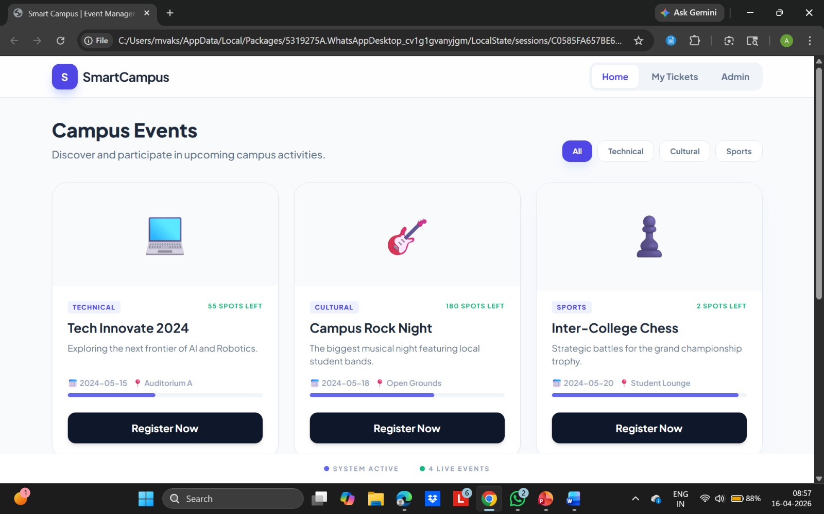
IMPLEMENTATION SCREENSHOTS
1
2
3
4
5
6
7
8
9

Slide 11
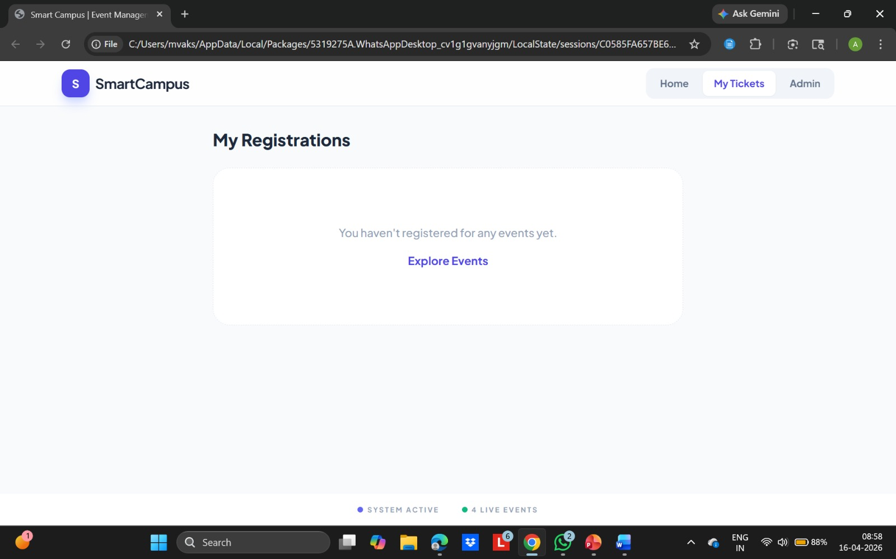
IMPLEMENTATION SCREENSHOTS
1
2
3
4
5
6
7
8(A)
9

Slide 12
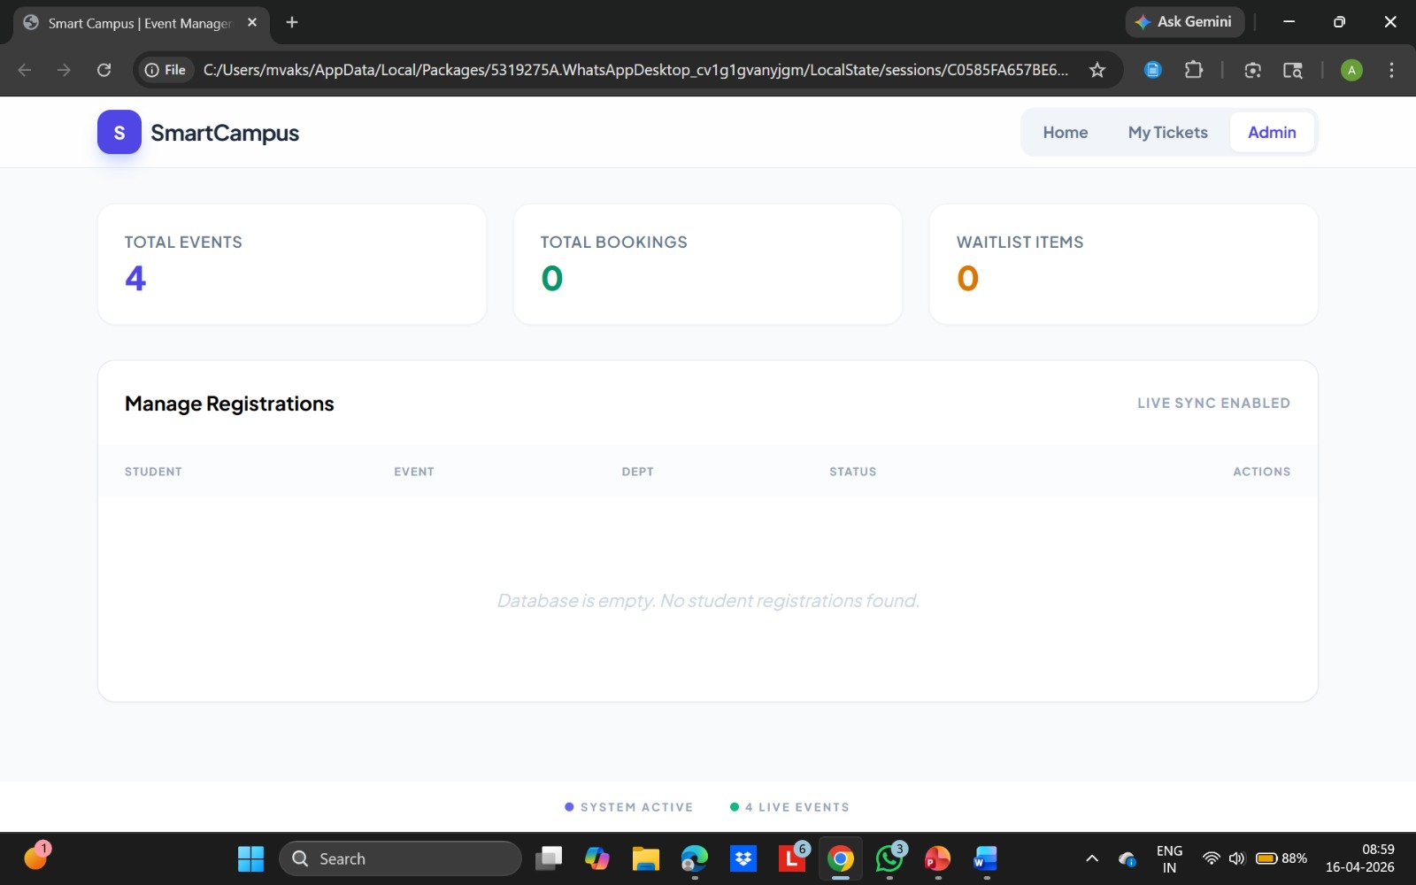
IMPLEMENTATION SCREENSHOTS
1
2
3
4
5
6
7
8(B)
9

Slide 13
ADVANTAGES & LIMITATIONS
ADVANTAGES
Provides a centralized platform to manage all campus events in one place
Reduces dependency on manual methods like notice boards and messages
Ensures real-time access to event updates and information
Improves communication between students and event organizers
Simplifies event registration process through an online system
Enhances student participation by making events easily accessible
LIMITATIONS
Requires stable internet connection to access the system
Basic user interface may not be highly interactive or modern
Limited to web platform (no mobile application support)
Notification system (email/SMS) not fully implemented
1
2
3
4
5
6
7
8
9

Slide 14
Thank you

